Slide 1

Bangladesh Army University of Science and Technology (BAUST) Saidpur Cantonment, Nilphamari
Department of Computer Science and Engineering (CSE)
Course Code: CSE 4000
Course Title: Project / Thesis
Title: Rabies Virus Prediction Using Machine Learning
Date:18/01/2026
Presented By:
Supervised By:
Abdullah Al Fahad (ID-220101010)
Turas Tasnim Aroni (ID-220101015)
A K Z Rasel Rahman
Lecturer, Dept. of CSE
Nadim Reza
Lecturer, Dept. of CSE

Slide 2
Outline
Introduction
Problem Statement
Related Works
Objectives
Proposed Methodology
Dataset
Results / Progress
Outcomes
Project / Thesis Timeline
Team Roles & Contributions
Conclusion
References

Slide 3
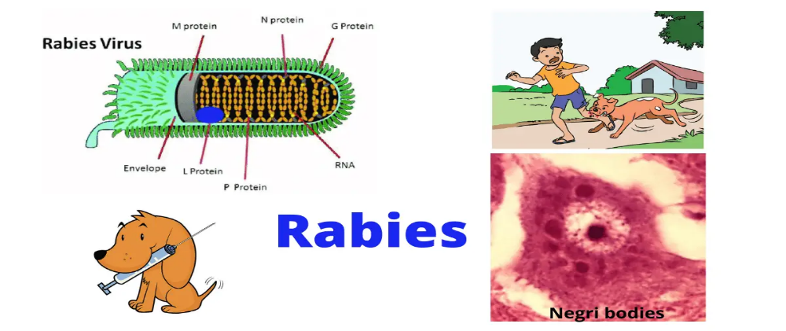
Introduction
Rabies causes about 59,000 deaths worldwide each year.
In Bangladesh, it is the third most affected country, with nearly 96% of human rabies cases linked to dog bites.
The estimated number of dogs in Bangladesh is approximately 1.67 million.
The dog population density is about 12.83 dogs per square kilometer.For every 86.7 humans, there is approximately 1 dog.
Figure.1 Rabis Virus [1]
[1]source: https://images.app.goo.gl/1UBPyfMU2TbtVUYf7

Slide 4
Problem Statement
Accurate predictions of rabies cases and ARV usage are essential for proper resource allocation and effective public health planning ;
There is a need to forecast the impact of vaccination programs and ARV usage on future rabies cases to ensure effective resource allocation and intervention planning ;
Developing predictive models will enable data-driven decision-making to enhance rabies control efforts and meet global rabies elimination targets;
No reliable time-series forecasting models exist to predict future rabies cases based on historical trends;

Slide 5
Related Works
Author(s) | Year | Titles | Short Summary | Limitation
A. Asare et al. | 2025 | Machine Learning-Based Prediction of Rabies Outbreaks Using Epidemiological and Environmental Data in Africa | ML models (RF, XGBoost, LightGBM) used to predict rabies outbreaks using epidemiological + environmental data. | Moderate accuracy; vaccination rate, mobility, and socio-economic factors not fully integrated.
A. A. Efat et al. | 2025 | BiLSTM-VHP: BiLSTM-Powered Network for Viral Host Prediction | BiLSTM model predicts viral hosts from genomic sequences | Lower performance for rabies compared to other viruses; dataset imbalance affects generalization.
M. Charles et al. | 2025 | Evaluating Stochastic CTMC and Deterministic Models in Rabies Persistence | Compares stochastic CTMC and deterministic models for rabies spread in human and dog population | High computational cost; real-world parameter estimation is difficult.

Slide 6
Related Works
H. Fawareh et al. | 2026 | AI and Machine Learning Applications in Disease Prediction Systems | Reviews AI/ML-based disease prediction systems with focus on public health decision support. | Mostly review-based; lacks large-scale experimental validation.
S. Rahman et al. | 2026 | Deep Learning Models for Zoonotic Disease Forecasting | Deep learning models applied to zoonotic disease forecasting including rabies-like infections. | Requires large labeled datasets; limited performance in low-resource regions.
Rabies Virus Prediction
6
18/01/2026

Slide 7
Objectives
Assess the relationship between dog vaccination rates and ARV usage on the number of human rabies cases.;
Develop a predictive model to forecast human rabies cases based on various features such as dogs vaccinated, ARV usage, and historical rabies data..
Forecast future human rabies cases and understand how interventions like dog vaccination and ARV treatment will impact the prevention and control of rabies in Bangladesh or any specific region.

Slide 8
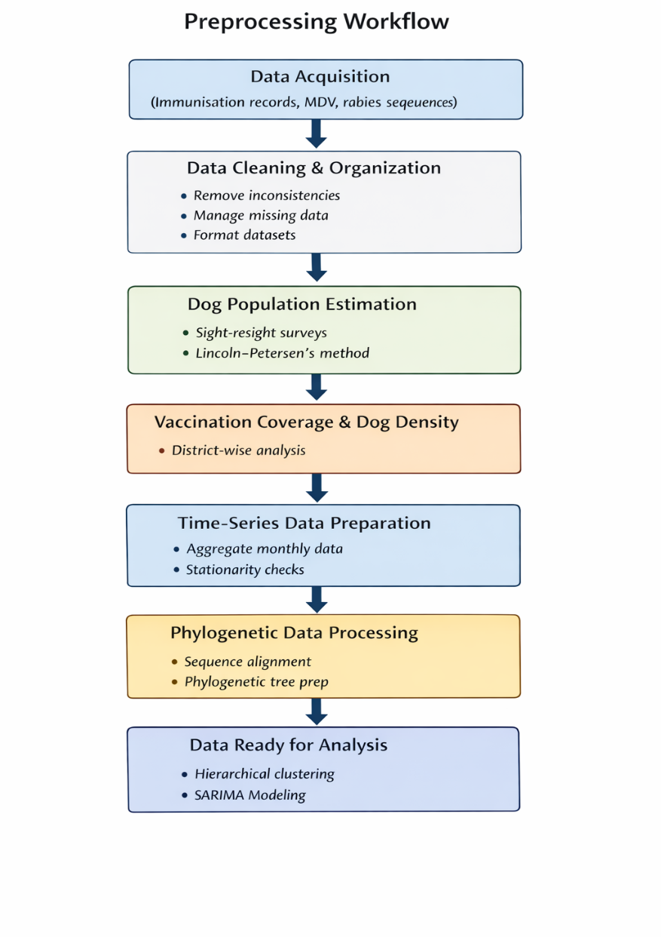
Proposed Methodology
Data Acquisition and Integration:
Collected data from multiple sources, including immunisation records, mass dog vaccination (MDV) databases, and rabies virus sequences.
Ensured data covered a consistent time frame for temporal analysis.
Data Cleaning:
Reviewed datasets for completeness and consistency, addressing discrepancies or missing values where possible.
Dog Population Estimation:
Calculated dog population density and human-to-dog ratios using district area data.
Vaccination Coverage Calculation:
Determined district-wise vaccination coverage by dividing the number of vaccinated dogs by estimated dog populations.
Calculated the number of vaccination rounds per district from program records..
Figure 2: Methodoly Diagram

Slide 9
Dataset Overview
The dataset consists of time-series records where each row represents monthly rabies-related data. The columns include temporal information (year and month), the number of dogs vaccinated, anti-rabies vaccine usage, and the corresponding number of human rabies cases. The target variable for prediction is human rabies cases, while the remaining columns are used as input features.
The dataset has imbalanced classes, with more positive rabies cases (1).
The dataset was split into 70% training and 30% testing
[2]sources:https://www.thelancet.com/journals/lansea/article/PIIS2772-3682(24)00102-1/

Slide 10
Dataset Overview (Cont.)
Year | Month | Number of dogs vaccinated | Human Rabies cases | Number of ARV Used
2012 | J | 0 | 7 | 10787
 | F | 0 | 10 | 10220
 | M | 214 | 2 | 11550
 | A | 8742 | 9 | 10780
 | M | 0 | 3 | 10500
 | J | 8151 | 2 | 10700
 | J | 6994 | 6 | 9580
 | A | 12576 | 6 | 12100
 | S | 8978 | 9 | 10200
 | O | 0 | 9 | 10100
 | N | 0 | 8 | 11800
 | D | 0 | 11 | 11127
2013 | J | 0 | 10 | 13327
 | F | 8826 | 8 | 12758
 | M | 0 | 6 | 13429
 | A | 5129 | 8 | 11783
 | M | 2134 | 3 | 12529
 | J | 0 | 5 | 13228
 | J | 0 | 5 | 12724
 | A | 0 | 6 | 12484
 | S | 0 | 9 | 15319
 | O | 0 | 5 | 16519
 | N | 0 | 8 | 17243
 | D | 0 | 9 | 15817
…………. | ………. | …….. | ……… | ..
Table:1
18/01/2026
Rabies Virus Prediction
10

Slide 11
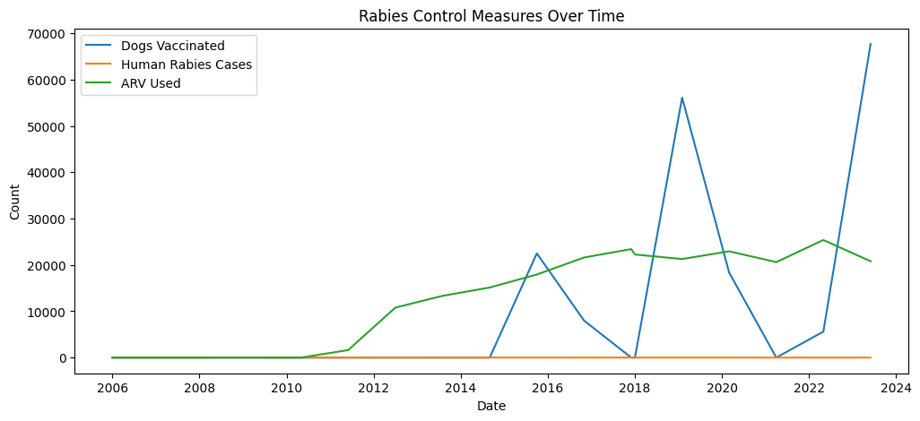
Dataset Overview (Cont.)
The graph shows the trends of rabies control measures over time with three different variables:
Dogs Vaccinated (Blue Line): This line represents the number of dogs vaccinated over the years. The trend shows sharp increases in vaccination efforts, particularly around certain years.
Human Rabies Cases (Orange Line): This line represents the number of human rabies cases over time. The data is relatively flat, indicating low numbers of human rabies cases, with only a few spikes in certain years.
ARV Used (Green Line): This line indicates the number of anti-rabies vaccines (ARV) used over the years. Similar to the vaccination data, this shows significant increases at certain points in time.
Dog vaccinations and ARV usage both show increasing trends, suggesting that vaccination programs and treatment efforts have been ramped up over time.
Human rabies cases remain low, indicating that the interventions might be working effectively to keep the cases under control
Figure 3:Rabies Control Measures Over Time
18/01/2026
Rabies Virus Prediction
11

Slide 12
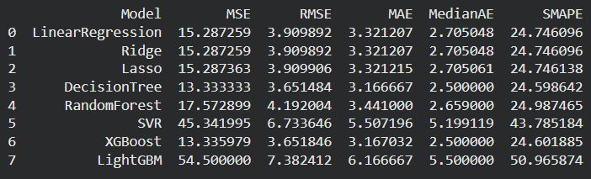
Results
Matrics | Description | Formula
MSE | Average of squared errors | MSE = (1/n) * Σ (yi - y_hat_i)^2
RMSE | Square root of MSE | RMSE = sqrt( (1/n) * Σ (yi - y_hat_i)^2 )
MAE | Average of absolute errors | MAE = (1/n) * Σ |yi - y_hat_i|
MedianAE | Median of absolute errors | MedianAE = median( |y1 - y_hat1|, |y2 - y_hat2|, ..., |yn - y_hatn| )
Metrics Used
Table:2

Slide 13
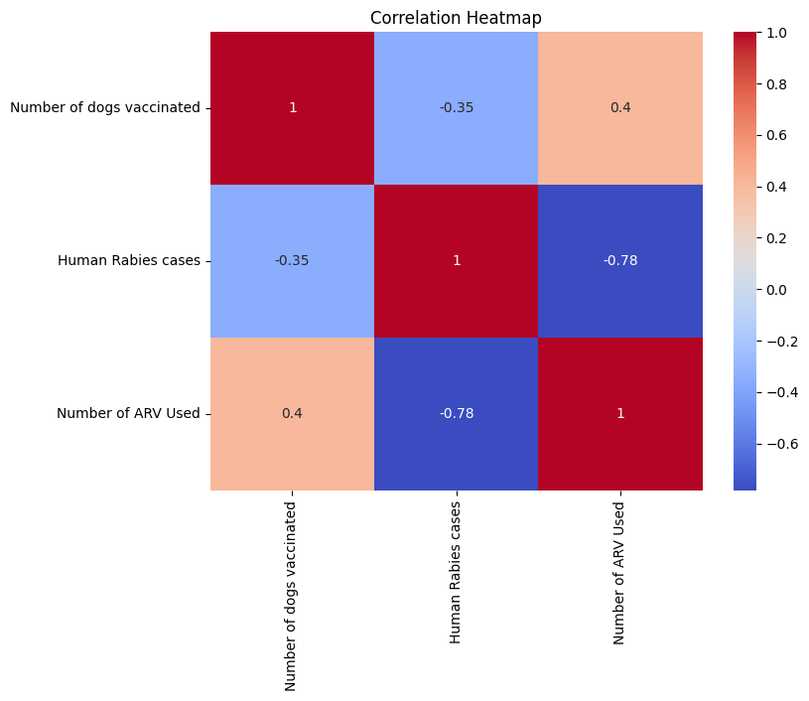
Results(Cont.)
Rabies Control Effectiveness: The negative correlation between dogs vaccinated and human rabies cases indicates that increasing dog vaccination is likely effective in controlling human rabies.
ARV Usage and Rabies Cases: The strong negative correlation between human rabies cases and ARV usage suggests that as rabies cases decline, ARV treatments are used less frequently.
Vaccination and ARV Usage: The positive correlation between dog vaccinations and ARV usage indicates that vaccination programs might be associated with a higher need for ARV, perhaps due to increased awareness or increased treatment needs in areas with higher exposure.
Figure 4:Correlation Heatmap
Rabies Virus Prediction
13
18/01/2026

Slide 14
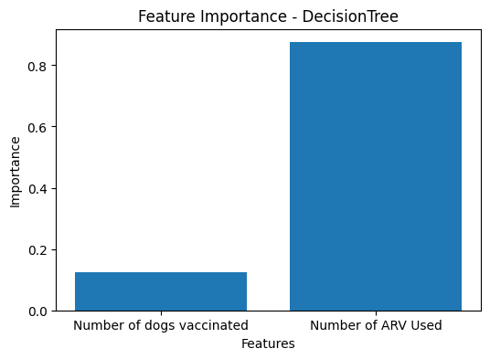

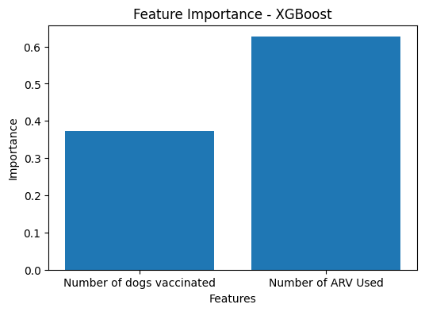
Results(Cont.)
Feature Importance by Different Model
Figure:5
Figure:6
Figure:7
Both models indicate that "ARV Used" is the primary feature for predicting rabies-related outcomes, while "Dogs Vaccinated" has a relatively low influence on the prediction.
Both "Number of ARV Used" and "Number of Dogs Vaccinated" are important features in predicting rabies outcomes, with ARV usage being the more influential feature according to the XGBoost model. This aligns with the idea that treatment (ARV) and vaccination are crucial components of rabies control and prevention efforts.

Slide 15
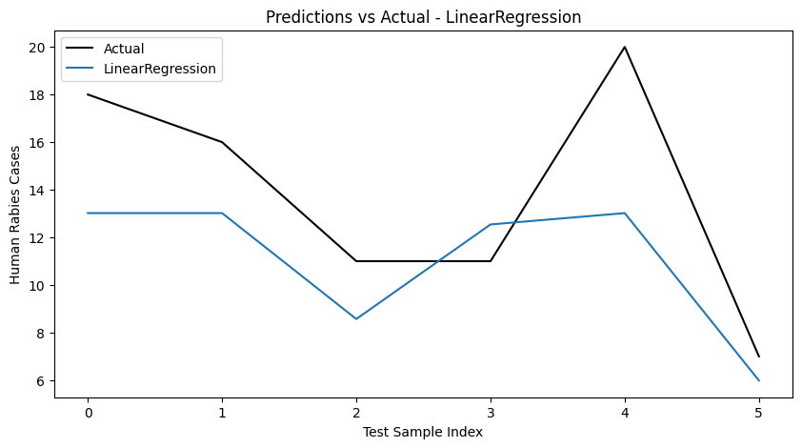
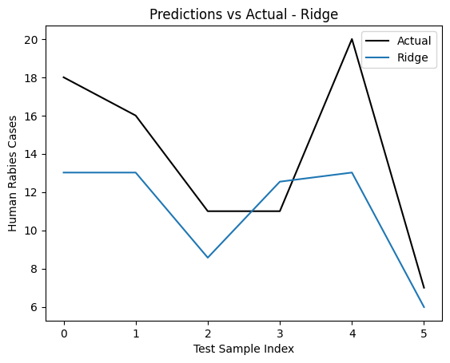

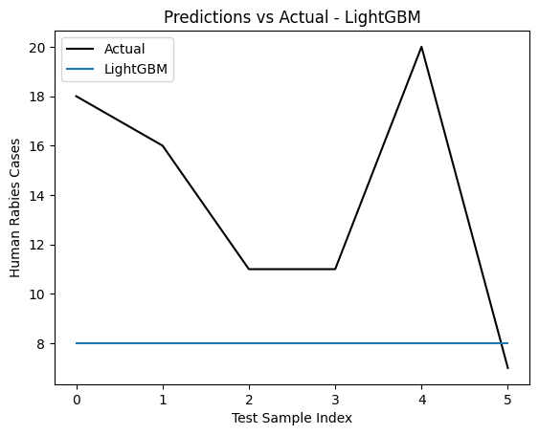
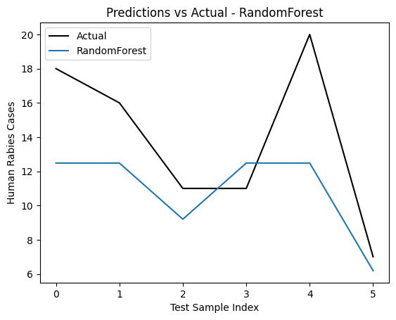
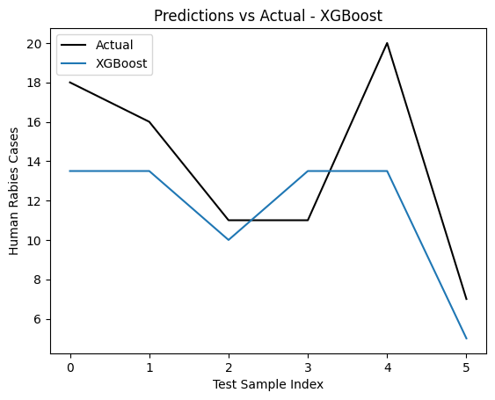
Results(Cont.)
Actual Vs Prediction by Different Model
18/01/2026
Rabies Virus Prediction
15

Slide 16
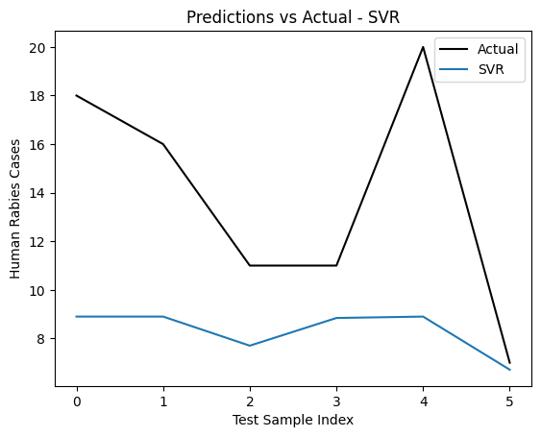
Results(Cont.)
Each model provides predictions for Human Rabies Cases but with varying degrees of accuracy.
Some models like Random Forest and XGBoost seem to provide a closer match to the actual data, while others like LightGBM need further adjustments to improve performance.
The SVR model is not performing well in this case and may need improvements such as:
Hyperparameter tuning (e.g., kernel, C, epsilon)
Trying other models like Random Forest, XGBoost, or LightGBM, which might better capture the underlying patterns in the data.
Rabies Virus Prediction
18/01/2026
16

Slide 17
Results(Cont.)
Model | Hyperparameter | What it does (very easy)
Linear Regression | None (default) | Fits a simple straight line
Ridge | alpha = 1.0 | Controls penalty strength
Lasso | alpha = 0.1 | Controls feature shrinking
Decision Tree | random_state = 42 | Keeps result reproducible
Random Forest | n_estimators = 100 | Uses 100 trees
 | random_state = 42 | Same output every run
SVR | kernel = 'rbf' | Captures non-linear patterns
XGBoost | n_estimators = 100 | Uses 100 boosted trees
 | objective = 'reg:squarederror' | Regression with MSE loss
 | random_state = 42 | Stable results
LightGBM | n_estimators = 100 | Uses 100 boosting rounds
 | random_state = 42 | Reproducible training
18/01/2026
17
Rabies Virus Prediction

Slide 18
Project / Thesis Timeline
.
Topic | Semester Weeks
 | 1 | 2 | 3 | 4 | 5 | 6 | 7 | 8 | 9 | 10 | 11 | 12 | 13 | 14 | 15 | 16 | 17 | 18 | 20 | 21 | 22 | 23 | 24 | 25 | 26 | 27 | 28
Research Topic Selection
Background & Related Works Study
Objective Finalization
Methodology Determination
Dataset Gathering
Model Implementation
Model Testing & Tuning
Report / Book Writing
Figure 4: Gantt chart for project / thesis timeline

Slide 19
Outcomes
A clean and structured time-series dataset for rabies prediction was developed and analyzed.
Multiple machine learning models were implemented and compared using standard evaluation metrics (MSE, RMSE, MAE, MedianAE).
Random Forest and LSTM models achieved the best predictive accuracy.
The proposed system can predict both past (back-testing) and future rabies cases using a universal prediction function.
The analysis highlighted the impact of dog vaccination and ARV usage on reducing human rabies cases.
The model can assist public health authorities in decision-making and rabies control strategies.

Slide 20
Team Roles and Contributions
Abdullah Al Fahad:
Data Preprocessing
Report Writing
Turas Tasnim Aroni:
Model Development
Evolution & Visualization
Collaboration Works:
Literature Review
Presentation Design

Slide 21
Conclusion
This study successfully demonstrated the application of machine learning techniques for predicting human rabies cases using time-series data.
By incorporating temporal factors, dog vaccination coverage, and anti-rabies vaccine (ARV) usage, the proposed models were able to learn meaningful patterns related to rabies transmission and control. Among the evaluated models, Random Forest and XGBoost showed superior performance compared to traditional approaches, indicating their suitability for rabies case prediction.
The results confirm that machine learning can be an effective tool to support rabies surveillance and prevention planning.
Dataset not that much bigError could be still be reduced.

Slide 22
References
Details of the NOS (oh et al., 2023; roderburg et al., 2021; Kurita et al., 2017; Musicco et al., 2013; Jørgensen et al., 2012; Khan et al., 2011; Baxter et al., 2009; ren et al., 2022; Valentine et al., 2022; Ording et al., 2019; Heun et al., 2013; OU et al., 2013; attner et al., 2010). [Preprint]. doi:10.7717/peerj.18888
Ding, Q., Wang, C., Wang, H., Xiang, C., Wang, Z., Wang, Y., ... & Kim, J. S. (2025). Rabies Virus Targeting NIR-II Phototheranostics. Journal of the American Chemical Society, 147(19), 16661-16673.
Regional flagship priorities of WHO South-East Asia: Fostering efficiency in public health - the Lancet regional health - Southeast Asia.
Charles et al., V. Orange County, New York, et al’ (no date) PsycEXTRA Dataset [Preprint]. doi:10.1037/e503482018-001.
Parker, C.T., Taylor, D. and Garrity, G.M. (2010) ‘Exemplar abstract for Psychrobacillus Psychrotolerans (Abd el-Rahman et al. 2002) krishnamurthi et al. 2011 and bacillus psychrotolerans Abd el-Rahman et al. 2002.’, The NamesforLife Abstracts [Preprint]. doi:10.1601/ex.4970.

Slide 23


